Slide 1
Design & Analysis of Algorithms Lecture 8
Growth of Functions - Asymptotic Notations

Slide 2
Analysis Framework
Two kinds of efficiency:
Time efficiency:
How fast an algorithm runs
Space efficiency:
Deals with extra memory space an algorithm requires
We often deal with time efficiency.

Slide 3
Time Efficiency: Units and Analyses
Standard unit of time measurement - a second, a millisecond, and so on
Measure the running time of a program implementing the algorithm.
Basic operation: the operation that contributes most towards the running time of the algorithm
Count the number of repetitions of the basic operation
Mathematical (or theoretical) analysis of an algorithm’s efficiency
Empirical (or experimental) analysis of an algorithm’s efficiency

Slide 4
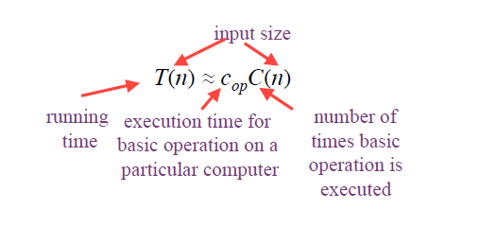
Mathematical Analysis
Time efficiency is analyzed by determining the number of repetitions of the basic operation as a function of input size.

Slide 5
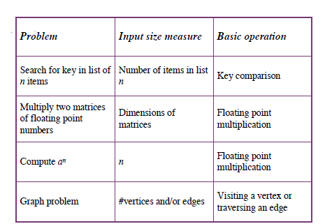
Examples: Input Size and Basic Operation

Slide 6
Best-case, Average-case, Worst-case
For some algorithms efficiency depends on type of input:
Worst case ( Big O)
W(n) – maximum over inputs of size n.
Best case: ( Omega)
B(n) – minimum over inputs of size n.
Average case: ( Theta)
A(n) – “average” over inputs of size n.

Slide 7
Example: Sequential Search
Problem:
Given a list of n elements and a search key K, find an element equal to K, if any.
Algorithm:
Scan the list and compare its successive elements with K until either a matching element is found (successful search) or the list is exhausted (unsuccessful search).

Slide 8
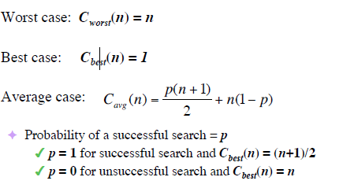
Example: Sequential Search Cont…

Slide 9
Order of Growth
Most important: Order of growth of the algorithm’s efficiency within a constant multiple as
Examples:
How much faster will algorithm run on computer that is twice as fast?
Two times.

Slide 10
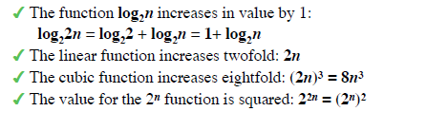
Order of Growth
How much longer does it take to solve problem of double input size?

Slide 11
Three Asymptotic Notations
Principal indicator of efficiency = Order of growth of basic operation count.
A way of comparing functions that ignores constant factors and small input sizes.
O(g(n)):
set of all functions f(n) with a smaller or same order of growth as g(n) (to within a constant multiple
Ω(g(n)):
set of all functions f(n) with a larger or same order of growth as g(n) (to within a constant multiple
Ѳ(g(n)):
set of all functions f(n) with the same order of growth as g(n) (to within a constant multiple,

Slide 12
Growth of Functions
We can sometimes determine the exact running time of the algorithm, however, the extra precision is not usually worth the effort of computing it.
For large inputs, the multiplicative constants and lower order terms of an exact running time are dominated by the effects of the input size itself.

Slide 13
Factor to consider when Analyzing Algorithms
Ignore constants. For example,
f(n) = 25n²
or
f(n) = 25n² + 2000
f(n) = O (n²)
Ignore small terms
f(n) = 25n³+ 30n² + 10n
f(n) = O (n³)
Application Independent
i.e. not dependent on any tool, platform or application.

Slide 14
Theta Notation ( Θ )
For a given function g(n), we denote by Θ( g(n) ) the set of functions
Θ( g(n) ) = { f(n) : there exist positive constants c1,c2 and n0 such that
0 ≤ c1.g(n) ≤ f(n) ≤ c2.g(n) for all n ≥ n0 }

Slide 15
C2.g(n)
f(n)
C1.g(n)
f(n) = Θ( g(n) )
n0
n
In the above figure, for all values of n to the right of n0, the value of f(n) lies at or above C1.g(n) and at or below C2.g(n).
In other words, for all n ≥ n0, the function f(n) is equal to g(n) to within constant factor.

Slide 16
Big-Oh Notation (O )
When we have only an asymptotic upper bound, we use O – notation. For a given function g(n), we denote by O( g(n) ) the set of functions
O( g(n) ) = { f(n) : there exist positive constants c, and n0 such that
0 ≤ f(n) ≤ c.g(n) for all n ≥ n0 }

Slide 17
c.g(n)
f(n)
n0
n
f(n) = O( g(n) )

Slide 18
Omega Notation ( Ω )
Just as O-notation provides an upper bound on a function, Ω notation provides an asymptotic lower bound. For a given function g(n), we denote by Ω( g(n) ) the set of functions
Ω( g(n) ) = { f(n) : there exist positive constants c, and n0 such that
0 ≤ c.g(n) ≤ f(n) for all n ≥ n0 }

Slide 19
f(n)
c.g(n)
n0
n
f(n) = Ω( g(n) )

Slide 20
Example:
Objective is to find the maximum of an
unordered set having N elements.
Input : An unordered list.
Output : Maximum of input set.
Algorithm
int Max = 0 //assume S[N] is filled with +ve numbers
For (int I = 0;I<N;I++)
{
If (S[I] > Max)
Max = S[I]
}
cout<< Max

Slide 21
Simple Analysis of previous Algorithm
Instruction No of times Executed cost
1 1 1
2 N N
3 - -
4 N N
5 N N
6 - -
7 1 1
So f(n) = 1 + N + N + N + 1 = 2 + 3N = 3N+2
so f(n) = O (N) or O (n)
Notes:
Write the program for two dimensional array. To calculate the quadratic running time.

Slide 22
Types of Functions (Bounding Functions )
Constant Function: O ( 1 )
For example, addition of two numbers will take same for Worst case, Best case and Average case.
Logarithmic Function: O ( log(n) )
Linear Function : O ( n )
O ( n.log(n) )
Quadratic Function : O (n²)
Cubic Function : O ( n³ )
Polynomial Function : O ( n^{k} )
Exponential Function : O ( 2^{n} )
etc…

Slide 23
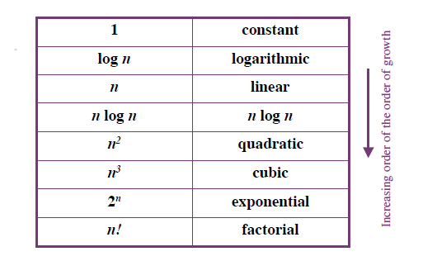
Basic Asymptotic Efficiency Classes

Slide 24
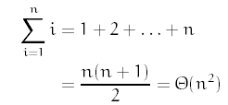
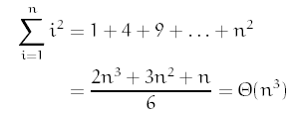
Mathematical Series
If 0 < x < 1 then this is Θ(1), and if x > 1, then this is Θ(x^{n}).

Slide 25
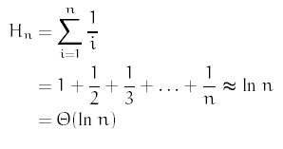
Mathematical Series
Harmonic series For n ≥ 0

Slide 26
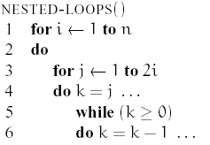
Analysis: A Harder Example
Let us consider a harder example.

Slide 27
Analysis: A Harder Example
How do we analyze the running time of an algorithm that has complex nested loop?
The answer is we write out the loops as summations and then solve the summations.
To convert loops into summations, we work from inside-out.

Slide 28
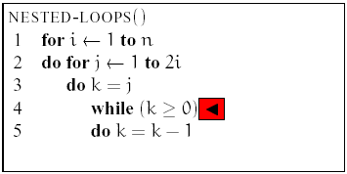

Consider the inner most while loop.
It is executed for k = j, j - 1, j - 2, . . . , 0. Time spent inside the while loop is constant. Let I() be the time spent in the while loop. Thus

Slide 29
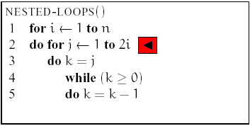
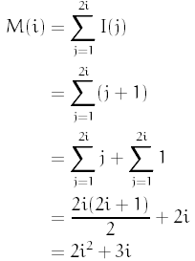
Consider the middle for loop.
Its running time is determined by i. Let M() be the time spent in the for loop:

Slide 30
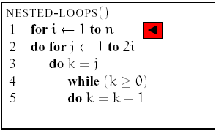
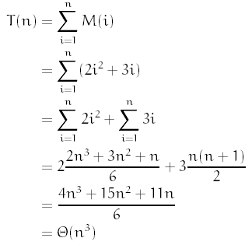
Finally the outer-most for loop.
Let T() be running time of the entire algorithm

Slide 31
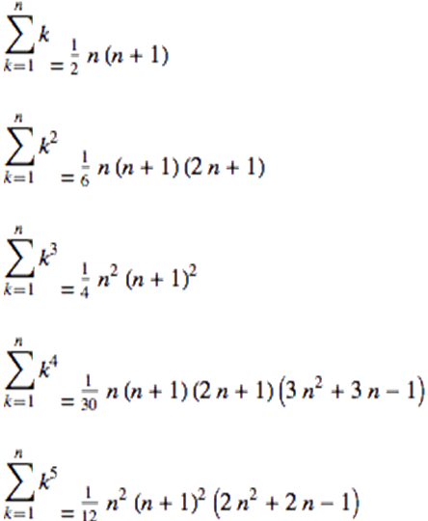
References: Mathematical Series*

Slide 32
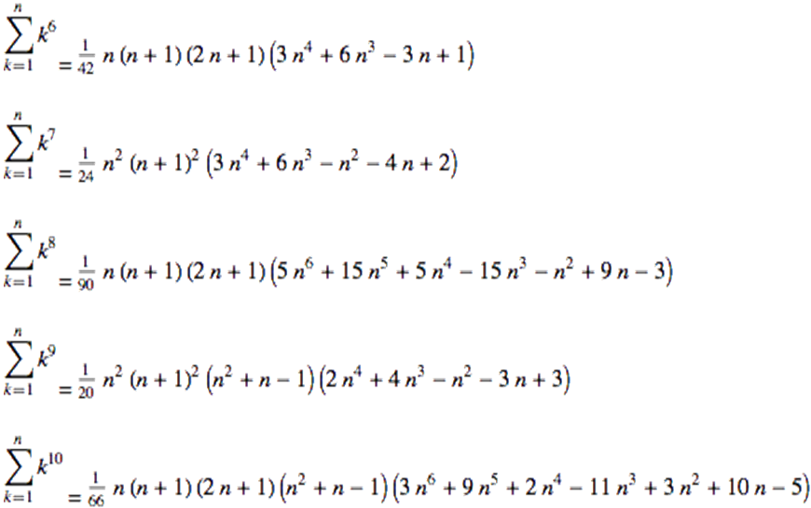
References: Mathematical Series

Slide 33
Empirical Analysis of Algorithms
A complementary approach to mathematical analysis is empirical analysis of an algorithm’s efficiency.
A general plan for the empirical analysis involves the following steps:
Understand the purpose of the analysis process (called experimentation)

Slide 34
Empirical Analysis of Algorithms
Decide on the efficiency metric to be measured and the measurement unit
Decide on characteristics of the input sample
Generate a sample of inputs
Implement the algorithm for its execution (to run computer experiment/simulation)
Execute the program to generate outputs
Analyze the output data.

Slide 35
Analyzing Output Data
Collect and analyze the empirical data (for basic counts or timings)
Present the data in a tabular or graphical form
Compute the ratios M(n)/g(n), where g(n) is a candidate to represent the
efficiency of the algorithm in question n Compute the ratios M(2n)/M(n) to see how the running time reacts to doubling of its input size

Slide 36
Analyzing Output Data
Examine the shape of the plot:
A concave shape for the logarithmic algorithm
A straight line for a linear algorithm
Convex shapes for quadratic and cubic algorithms
An exponential algorithm requires a logarithmic scale for the vertical axis.

